Slide 1

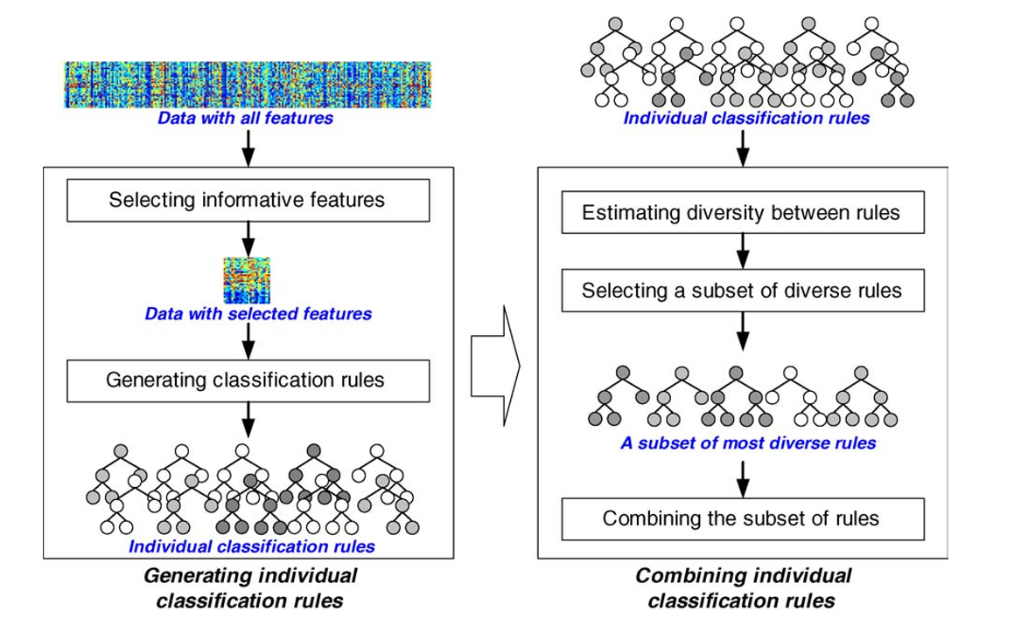
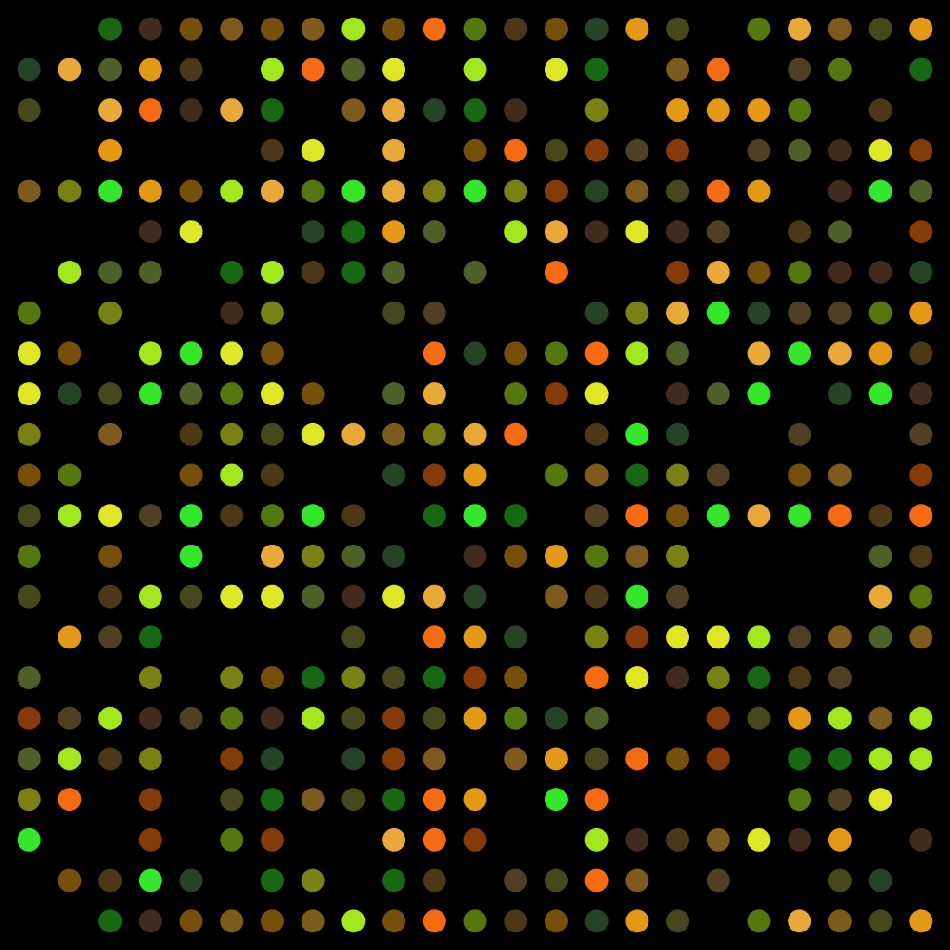
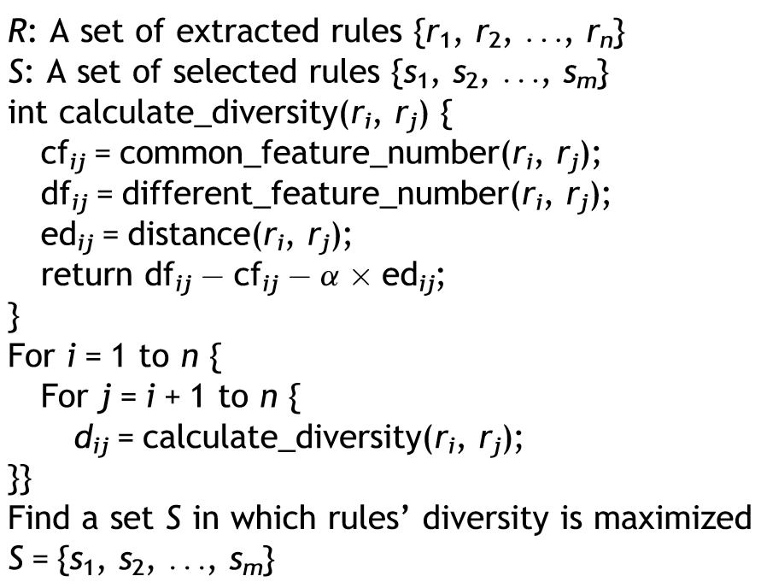
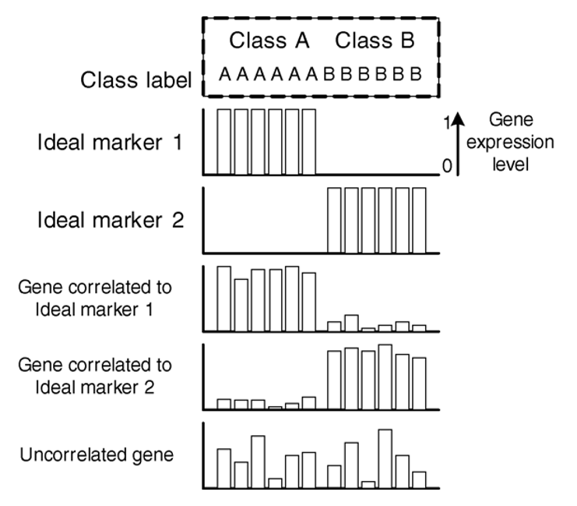
Microarrays and Proteomics for Cancer Detection
Roshni Biswas (Roll # 114CS0011)
Department of Computer Science and Engineering
National Institute of Technology, Rourkela
ABSTRACT
PROPOSED ALGORITHM
A gene expression proﬁle obtained from a microarray is simply a snapshot of the current state of the tissue. In this study the advantages of statistical gene selection are combined with the power of Genetic Programming to build classiﬁers for assigning gene expression microarray data samples to categories characteristic of certain cell states.
INTRODUCTION TO DNA MICROARRAYS
Red: increase of expression
Yellow: equal expression
Green: decrease of expression
Fig 1. DNA microarray chip containing 2400 human genes
The data is represented as n × m matrices, where n = number of samples, m = number of genes. For each sample an m-dimensional vector of expression values is available, 1 entry for each gene i with 1 ≤ i ≤ m. For each gene, there exists an n-dimensional vector with one expression value for each sample j with 1 ≤ j ≤ n. Each dataset contains an additional vector of size n which holds the class label of samples describing their phenotype. [1]
Fig 3. Proposed Algorithm Flowchart
Five classification rules are fused to form an ensemble classifier with the following algorithm.
THEORY
CONCLUSION
New opportunities arise by analyzing these patterns to reveal cancer types and state of progress enabling better treatment. [2]
The proposed ensemble classifier shows superior classification performance on combining five rules. This method was found to be better than other machine learning techniques including diversity measurement using neural networks.
ML techniques for classification:
Artificial Neural Networks
Bayesian approaches
Support Vector Machines
Decision Trees
K-nearest Neighbours
Further approaches to analyze the data are:
Genetic Algorithm for feature selection
Ensemble approaches
Evolutionary Techniques [3]
Fig 4. Ensemble Algorithm
REFERENCES
[1] Hong, J. H., & Cho, S. B. (2006). Classification of cancer based on DNA microarray data that uses diverse ensemble GP. Artificial intelligence in Medicine, 36(1), 43-58.
[2] Rosskopf, Michael, et al. Genetic programming based DNA microarray analysis for classification of cancer. Memorial University, (2007).
[3] Lu, Ying, and Jiawei Han. "Cancer classification using gene expression data." Information Systems 28.4 (2003): 243-268.
Fig 2. Gene Expression Classification

